Slide 1
Machine Learning in Spectral CT
Hengyong Yu, PhD
University of Massachusetts Lowell
1/21/2020

Slide 2
Outline
1. Introduction
2. Model & Optimization
3. Experiment results
4. Discussion & Conclusion

Slide 3
Introduction
Compressive Sensing
Machine Learning
Sparsity
To apply the CS technique in the CT field, the key is to explore the sparsity in a transform domain, and machine learning plays an important role for this goal.

Slide 4
Introduction
2009
We developed the CS-based interior tomography theory and algorithms to solve the long-standing “interior problem” for high-fidelity local reconstruction

Slide 5
Introduction
2012
We applied the dictionary learning technique for low-dose CT reconstruction.

Slide 6
Introduction
2013
Learning based method for imaging biomarkers
Funded Project (NIH/NIBIB R21 EB019074)
Proposal first submission date: Nov. 2013, with Ge Wang at RPI)

Slide 7
Introduction
2017

Slide 8
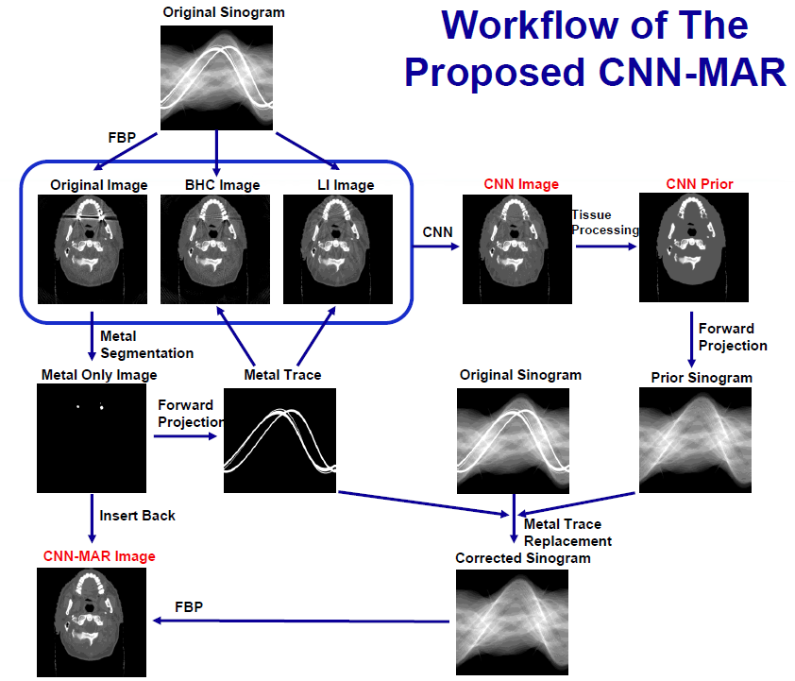
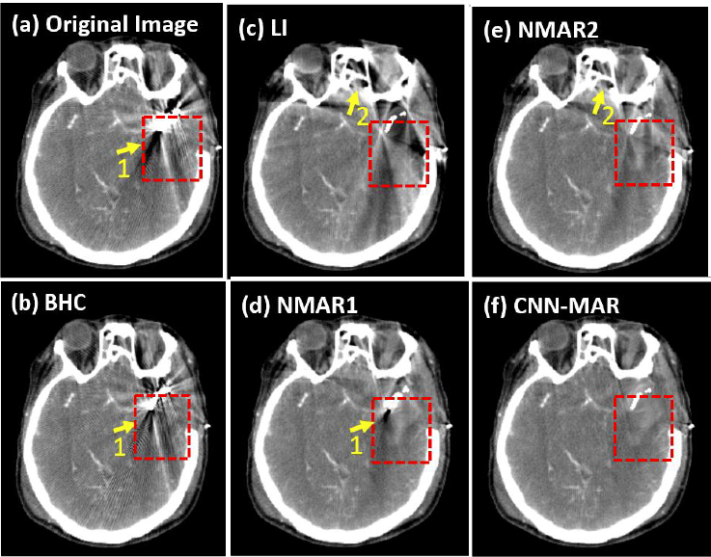
Introduction
2018

Slide 9
Introduction
2019

Slide 10




Introduction
Focus of this talk (Under Review)

Slide 11
Introduction
Material decomposition:
I. Direct material decomposition methods: directly obtain material components using x-ray spectrum from projections
Pros:
Avoid the x-ray beam hardening artifacts;
Regularization prior can penalize material maps;
Cons:
The real x-ray spectrum is difficult to achieved;
Projection noise can be amplified in projection decomposition;
II. Indirect material decomposition methods: including projection-based and image-based methods
Pros:
The regularization prior can penalize projections or reconstructed map images;
Image-based methods can reduce noise well;
Pros:
Cannot avoid x-ray beam hardening artifacts;

Slide 12
Introduction
Material decomposition methods:
Spectral CT images (attenuation maps at from all energy bins) are available using image reconstruction methods (such as FBP, etc)
Conventional image-domain decomposition
Direct matrix inversion decomposition⁴
Sensitive to artifacts and noise.
Regularized (model-based) decomposition
Statistical measurement model + Object prior model
Improves image quality and decomposition accuracy
[4] [ Zhang et al., IEEE T-MI, 2016]

Slide 13
Introduction
Regularization methods for material decomposition:
Material decomposition with prior knowledge aware iterative denoising (MD-PKAID) ⁵
Retain structure details by exploring the structural redundancy
The material accuracy and image quality depending on prior image
Density, local joint Sparsity and structural low-Rank (DSR) ⁶
Artifact reduction with improvement of material accuracy
Ignores the physical effects with many parameters
Validate only on numerical phantom
^{[5] [ Tao} et al., Physical in medicine and biology, ^{2018]}
^{[6] [} ^{Xie} et al., Journal of Nondestructive Evaluation, 2019]

Slide 14
Outline
1. Introduction
2. Model & Optimization
3. Experiment results
4. Discussion & Conclusion

Slide 15
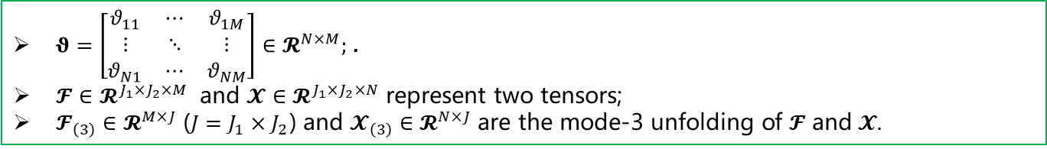
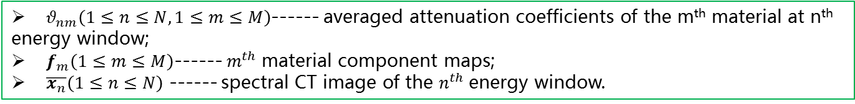
Model formulation
Material decomposition basic model⁷
(1)
$θ_{nm}\left(1≤n≤N,1≤m≤M\right)$------ averaged attenuation coefficients of the m^{th} material at n^{th} energy window;
$f_{m}\left(1≤m≤M\right)$------ $m^{th}$material component maps;
$\overline{x_{n}}\left(1≤n≤N\right)$ ------ spectral CT image of the $n^{th}$energy window.
The matrix form of Eq. (1) can be formulated as
(2)
$θ=\left[\begin{matrix}θ_{11} & ⋯ & θ_{1M} \\ ⋮ & ⋱ & ⋮ \\ θ_{N1} & ⋯ & θ_{NM}\end{matrix}\right]∈𝓡^{N×M};$ .
$𝓕∈𝓡^{J_{1}×J_{2}×M}$ and $𝓧∈𝓡^{J_{1}×J_{2}×N}$ represent two tensors;
$𝓕_{\left(3\right)}∈𝓡^{M×J}$ ($J=J_{1}×J_{2}$) and $𝓧_{\left(3\right)}∈𝓡^{N×J}$ are the mode-3 unfolding of $𝓕$ and$𝓧.$
^{[7] [Wu} ^{et al., Arxiv, 2019]}
[8] [Wu et al, IEEE Access, 2019]

Slide 16
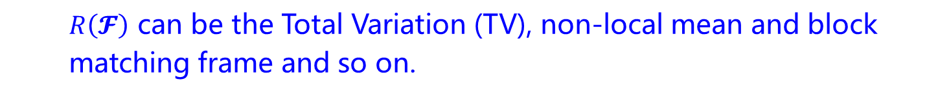
Model formulation
Considering noise in the reconstructed images, Eq. (2) can be read as
(3)
$η \text{−−−−−−}$the noise level
(4)
$R\left(𝓕\right)$------ the regularization term
$λ \text{−−−−−−}$the regularized parameter
$R\left(𝓕\right)$ can be the Total Variation (TV), non-local mean and block matching frame and so on.
^{[7] [} ^{Wu} ^{et al., Arxiv, 2019]}

Slide 17
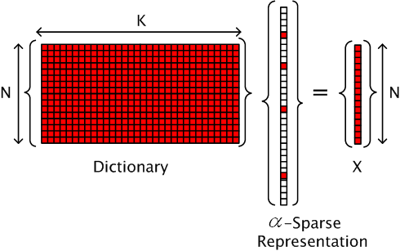
Model formulation
The idea of vectoried dictionary learning (DL):
Dictionary
Image patch
Sparse representation
Given a training set of patches, ,( ), the dictionary learning is to solve

Slide 18
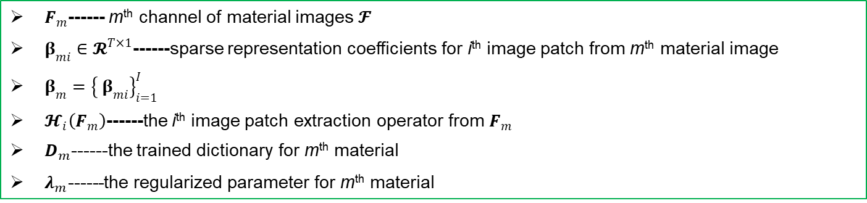
Model formulation
The conventional dictionary learning based image-domain material decomposition can be expressed as
(5)
The data fidelity term
Dictionary learning regularization term
$F_{m}$------ m^{th} channel of material images $𝓕$
$β_{mi}∈𝓡^{T×1}$------sparse representation coefficients for i^{th} image patch from m^{th} material image
$β_{m}={\left\{ β_{mi}\right\}}_{i=1}^{I}$
$𝓗_{i}\left(F_{m}\right)$------the i^{th} image patch extraction operator from $F_{m}$
$D_{m}$------the trained dictionary for m^{th} material
$λ_{m}\text{−−−−−−}$the regularized parameter for m^{th} material
^{[7] [} ^{Wu} ^{et al., Arxiv, 2019]}

Slide 19



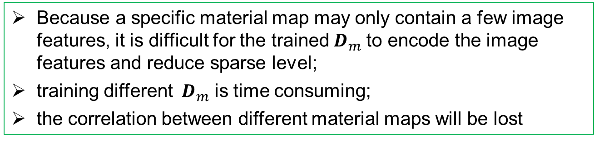
Model formulation
Cons of conventional dictionary learning based image-domain material decomposition:
Because a specific material map may only contain a few image features, it is difficult for the trained${ D}_{m}$ to encode the image features and reduce sparse level;
training different ${ D}_{m}$ is time consuming;
the correlation between different material maps will be lost
(b)
(a)
Soft tissue[0 1]
Iodine [0 0.012]
Bone [0 1]
(c)
Three basis materials of numerical mouse
^{[7] [} ^{Wu} ^{et al., Arxiv, 2019]}

Slide 20
Model formulation
Solution
Training a unified dictionary using image patches from all material images;
The normalization strategy is operated on the training material image to avoid the data inconsistency of material images;
The conventional dictionary learning based image-domain material decomposition can be expressed as
(6)
The data fidelity term
Dictionary learning regularization term
$\hat{D}$------the trained unified dictionary
^{[7] [} ^{Wu} ^{et al., Arxiv, 2019]}

Slide 21
Model formulation
Additional conditions
If the air is also treated as one basis material, the summation of pixel values of different material images at the same location should be equal to one, i.e.,
(7)
$AIR$ is the air map and ${AIR}_{j_{1}j_{2}}$ represents the binary pixel value at ${\left(j_{1},j_{2}\right)}^{th}$ location. A threshold method is applied to determine the air map (0 or 1).
The pixel value within $𝓕$ should be in the range of [0 1],i.e.,
(8)
^{[7] [} ^{Wu} ^{et al., Arxiv, 2019]}

Slide 22
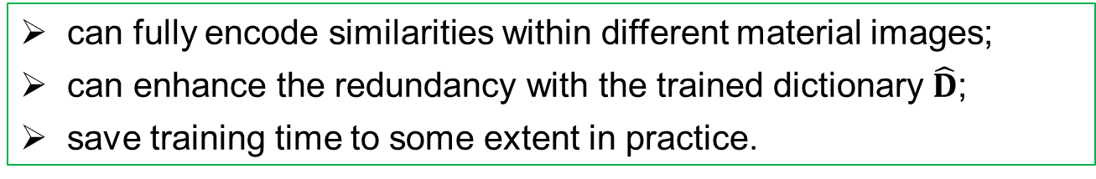
Model formulation
Considering Eqs. (7) and (8), the proposed dictionary learning based image-domain material decomposition (DLIMD) method can be formulated as
(9)
Pros:
can fully encode similarities within different material images;
can enhance the redundancy with the trained dictionary $\hat{D}$;
save training time to some extent in practice.
^{[7] [} ^{Wu} ^{et al., Arxiv, 2019]}

Slide 23
Optimization
Introducing tensor $𝓤$ to replace $𝓕$, Eq. (9) can be converted into
(10)
Eq. (10) can be divided into two sub-problem
(11a)
(11b)
^{[7] [} ^{Wu} ^{et al., Arxiv, 2019]}

Slide 24
Optimization
As for Eq. (11a), it can be simplified as⁷
(12)
Eq. (12) is a constrained least square problem and it can be easily solved.
For Eq. (11b) can be divided into the following problem
(13)
where $τ_{m}=λ_{m}/η$, the Eq. (13) can be solved by using the method in [8]
^{[7] [} ^{Wu} ^{et al., Arxiv, 2019]}
^{[9] [} ^{Wu} ^{et al., APM, 2018]}

Slide 25
Outline
1. Introduction
2. Model & Optimization
3. Experiment results
4. Discussion & Conclusion

Slide 26
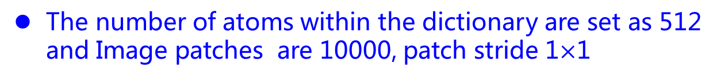
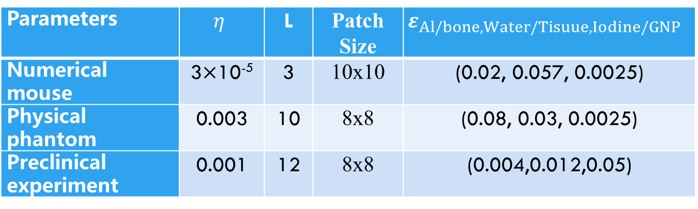
Implementation
Comparisons: Direct inversion (DI) method, total variation material decomposition (TVMD) method
The iteration number is 30 and the parameters in Table I
The number of atoms within the dictionary are set as 512 and Image patches are 10000, patch stride 1$×$1
Other parameters are in the following Table
Parameters | $$η$$ | L | Patch Size | $$ε_{Al/bone, Water/Tisuue, Iodine/GNP}$$
Numerical mouse | 3$×$10⁻⁵ | 3 | 10x10 | (0.02, 0.057, 0.0025)
Physical phantom | 0.003 | 10 | 8x8 | (0.08, 0.03, 0.0025)
Preclinical experiment | 0.001 | 12 | 8x8 | (0.004,0.012,0.05)
^{[7] [} ^{Wu} ^{et al., Arxiv, 2018]}

Slide 27
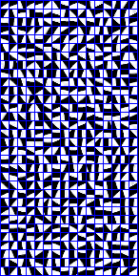
Implementation
Three indexes, i.e., RMSE, PSNR and SSIM are employed
The unified dictionaries used in numerical mouse, physical phantom and preclinical experiment
The dictionaries are trained from DI results of numerical mouse, physical phantom and preclinical experiment
^{[7] [} ^{Wu} ^{et al., Arxiv, 2018]}

Slide 28
Section I: Numerical mouse
Material decomposition from FBP mouse results
1
True
Bone
Soft tissue
Iodine
DI
The display windows of 1st-3rd columns are [0.01, 0.2], [0.25 0.55] and [0.0007 0.003]

Slide 29
Section I: Numerical mouse
Material decomposition from FBP mouse results
TVMD
DLIMD
The display windows of 1st-3rd columns are [0.01, 0.2], [0.25 0.55] and [0.0007 0.003]
^{[8] [} ^{Wu} ^{et al., APM, 2018]}

Slide 30
Section I: Numerical mouse
Table I. Quantitative evaluation results of three basis materials.
 |  | RMSE(10⁻²) | PSNR | SSIM
Bone | DI | 8.719 | 21.191 | 0.9314
 | TVMD | 8.279 | 21.641 | 0.9439
 | DLIMD | 7.873 | 22.077 | 0.9461
Soft tissue | DI | 13.890 | 17.146 | 0.7834
 | TVMD | 12.910 | 17.782 | 0.8491
 | DLIMD | 12.368 | 18.154 | 0.8646
Iodine contrast agent | DI | 0.0853 | 61.380 | 0.9056
 | TVMD | 0.0734 | 62.682 | 0.9214
 | DLIMD | 0.0688 | 63.251 | 0.9393

Slide 31
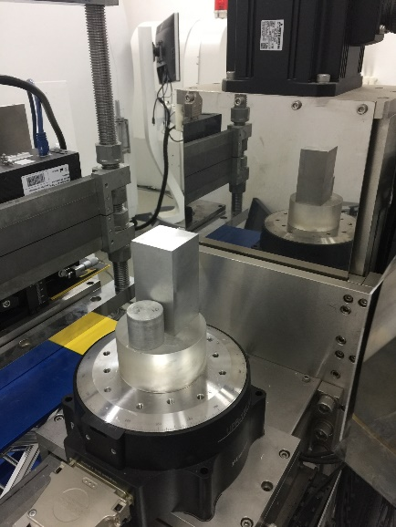
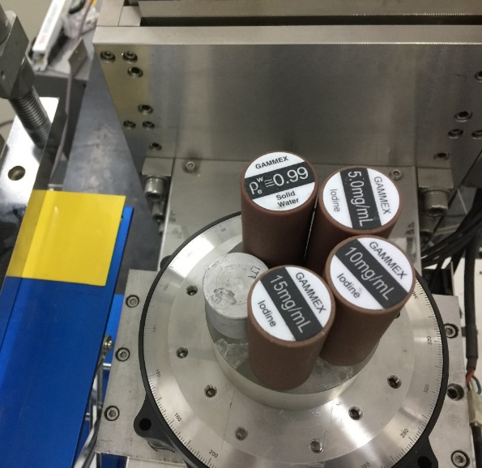
Section II: Physical phantom
Experiment set-up
A micro-focus x-ray source (YXLON, 225Kv)
A flat-panel PCD (Xcounter, XC-Hydra FX20)
2048 detector cells, 1080 views, 137kV, SOD: 182.68mm, SDD:440.50mm
256x256 image size
PCD
Water
5mg/uL
Iodine
Aluminum
10mg/uL
Iodine
15mg/uL
Iodine
(a)
(b)
(c)
Setups of physical phantom experiments. (a) is the spectral CT system, (b) and (c) represent the physical phantom.

Slide 32
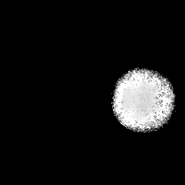
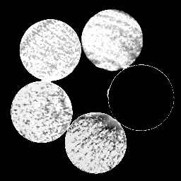
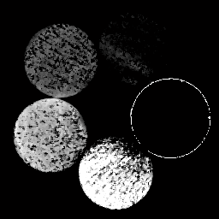
Section II: Physical phantom
Material decomposition results
Aluminum
Water
Iodine
ROI2
ROI3
DI
ROI1
ROI4
ROI5
From left to right, the columns represent the decomposition results of aluminum, water and iodine, where the display windows are [0.5 1], [0.8 1] and [0 0.003].

Slide 33

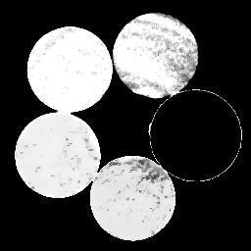
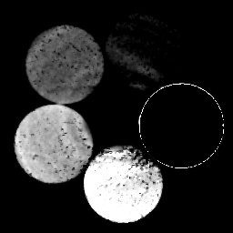
Section II: Physical phantom
Material decomposition results
Aluminum
Water
Iodine
TVMD
From left to right, the columns represent the decomposition results of aluminum, water and iodine, where the display windows are [0.5 1], [0.8 1] and [0 0.003].

Slide 34


Section II: Physical phantom
Material decomposition results
Aluminum
Water
Iodine
DLIMD
From left to right, the columns represent the decomposition results of aluminum, water and iodine, where the display windows are [0.5 1], [0.8 1] and [0 0.003].

Slide 35
Section II: Physical phantom
Table II. Quantitative evaluation results of ROI 1-5
 |  | RMSE(10⁻⁴) | PSNR | SSIM
ROI-1 | DI | 889 | 21.026 | 0.9882
 | TVMD | 861 | 21.299 | 0.9882
 | DLIMD | 828 | 21.635 | 0.9925
ROI-2 | DI | 324 | 29.796 | 0.9732
 | TVMD | 291 | 30.718 | 0.9913
 | DLIMD | 271 | 31.329 | 0.9977
ROI-3 | DI | 5.253 | 65.593 | 0.4118
 | TVMD | 2.196 | 73.169 | 0.7588
 | DLIMD | 1.812 | 74.839 | 0.8483
ROI-4 | DI | 6.854 | 63.281 | 0.6200
 | TVMD | 3.009 | 70.431 | 0.8625
 | DLIMD | 2.399 | 72.400 | 0.9165
ROI-5 | DI | 12.530 | 58.041 | 0.6204
 | TVMD | 7.780 | 62.180 | 0.8549
 | DLIMD | 7.639 | 62.340 | 0.8945

Slide 36
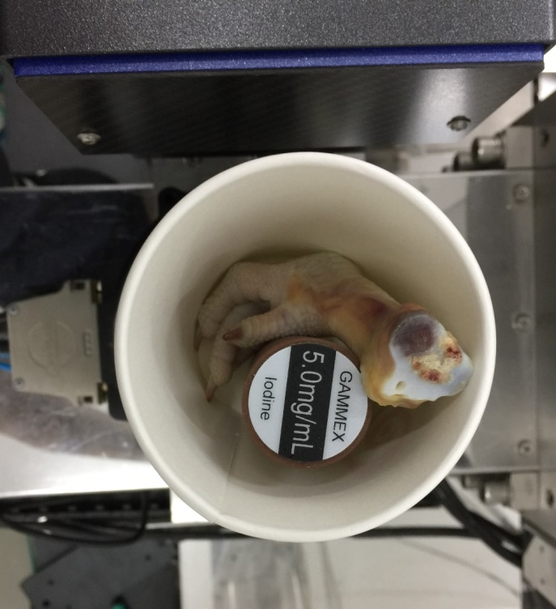
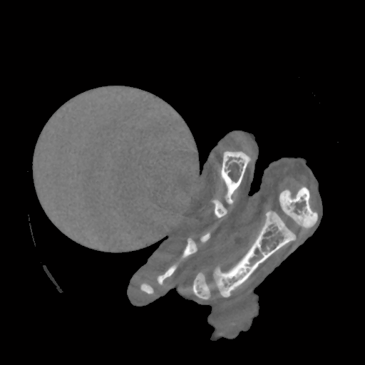

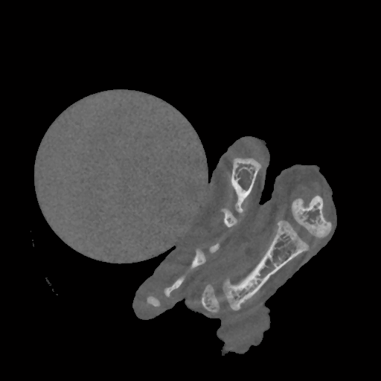
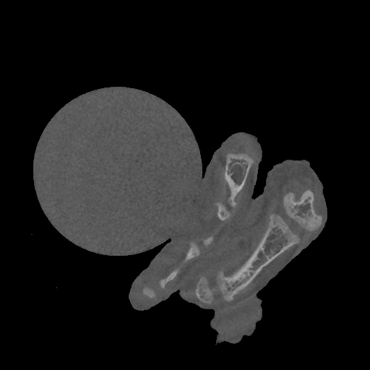
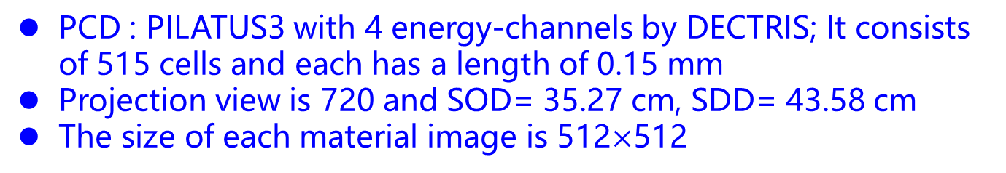
Section III: Preclinical experiment
PCD : PILATUS3 with 4 energy-channels by DECTRIS; It consists of 515 cells and each has a length of 0.15 mm
Projection view is 720 and SOD= 35.27 cm, SDD= 43.58 cm
The size of each material image is 512$×$512
(b)
(c)
(a)
(d)
(e)
Preclinical experiment. (a) is the preclinical specimen fixed on the spectral CT system. (b)-(e) are FBP reconstruction results from 4 energy bins, where the display window is [0 0.5] cm⁻¹

Slide 37
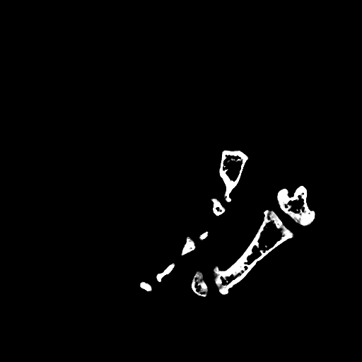


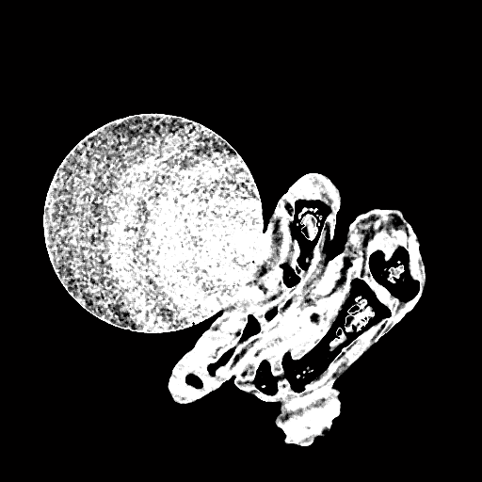
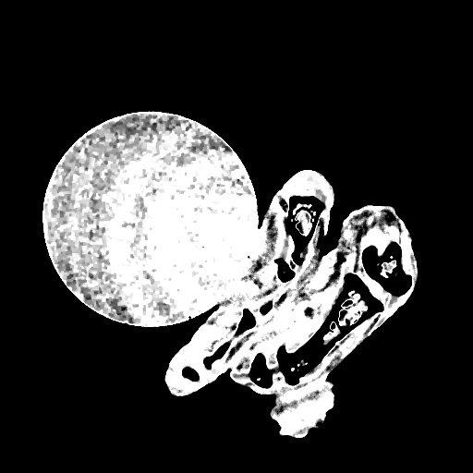




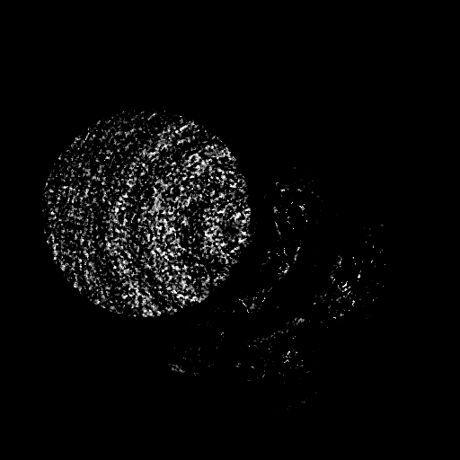
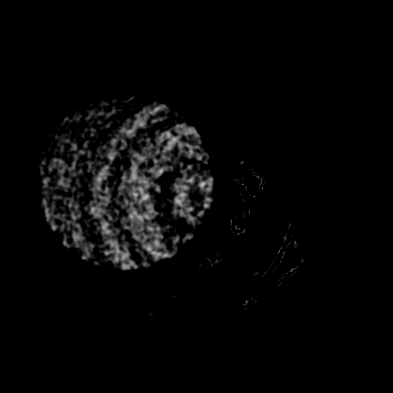
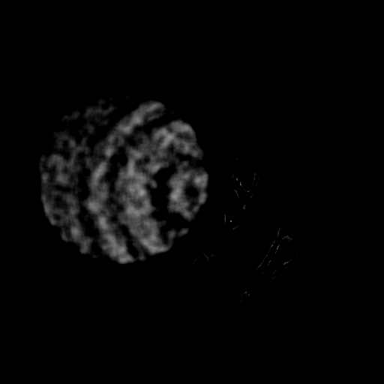
Section III: Preclinical experiment
Material decomposition results
DI
TVMD
DLIMD
Bone
A
B
Soft tissue
C
D
ROI 6
Iodine contrast agent
E
The 1st-3rd rows represent the bone, soft tissue and iodine with the display windows [0.25 0.5], [0.85 0.95] and [0.0018 0.005].

Slide 38



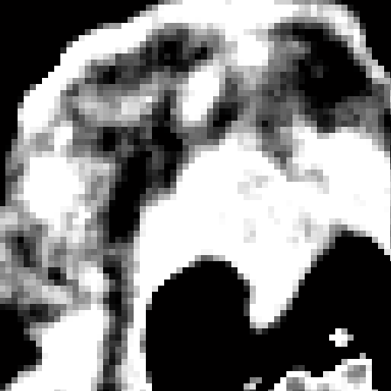


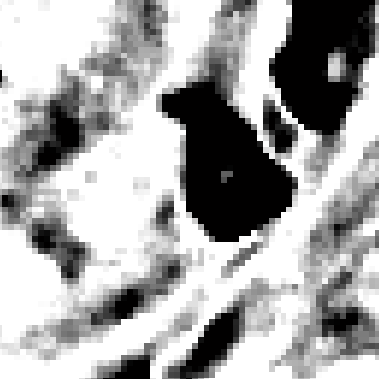
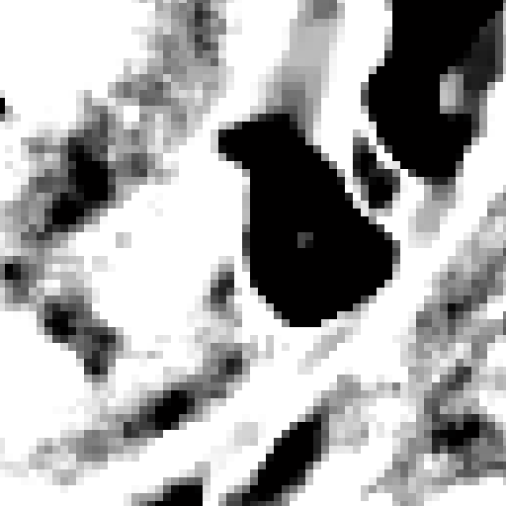
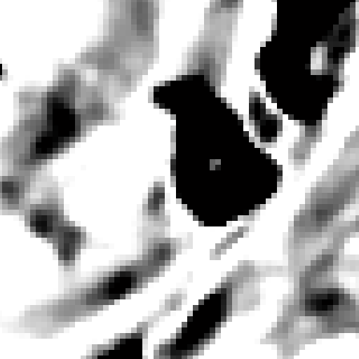
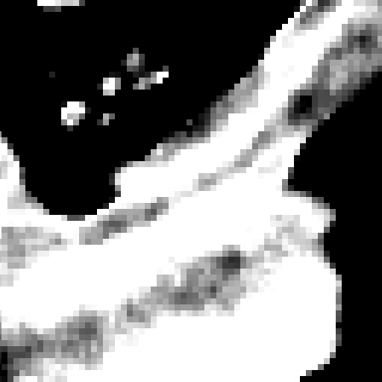
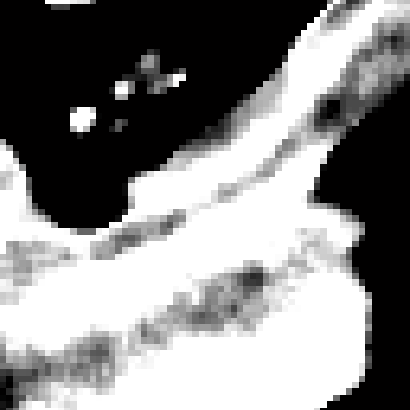
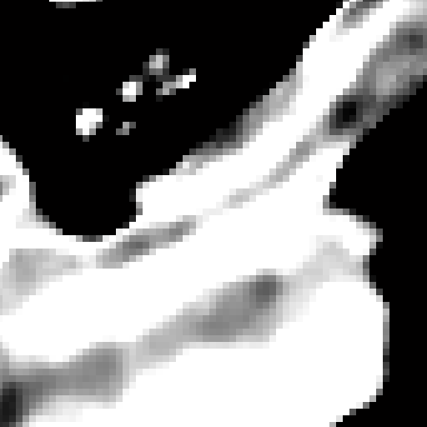
Section III: Preclinical experiment
Material decomposition results
DI
TVMD
DLIMD
The 1st-4th rows represent the ROIs marked with “A”, “B”, “C” and “D”, where the display windows are [0.29 0.33], [0.85 0.95], [0.85 0.95] and [0.85 0.95].

Slide 39
Outline
1. Introduction
2. Model & Optimization
3. Experiment results
4. Discussion & Conclusion

Slide 40
Discussion and conclusion
Discussion
Parameters are chosen empirically in the proposed DLIMD
The numerical mouse and two real datasets only contain three different basis materials, however the imaging objects may contain multiple (greater than 3) materials
Conclusion
Considering the similarities of different material images, we construct a unified dictionary to encode material image sparsity by training a set of image patches
Formulating a DLIMD mathematical model by enhancing sparsity of material maps with the dictionary
additional constraints are incorporated into the model to further improve the decomposition accuracy

Slide 41
Question?

