Slide 1
Learning from Raw Data
For Monochromatic Imaging
Wenxiang Cong, Ge Wang
Biomedical Imaging Center, CBIS/BME/SoE
Rensselaer Polytechnic Institute
November 19, 2017

Slide 2
Outline
Introduction
Dual-energy Data Decomposition
Monochromatic Imaging
Discussions

Slide 3
Outline
Introduction
Dual-energy Data Decomposition
Monochromatic Imaging
Discussions

Slide 4
X-ray Monochromatic Imaging
Quantify absorption, scattering, electrical density, and atomic number
Reduce beam-hardening
Perform material discrimination
Facilitate detection & diagnosis

Slide 5
Basic Framework
Numerical Training
Dual-energy Datasets
Dual-energy Network
Projection Decomposition
Monochromatic Projection
Grayscale Image
Monochromatic
Network
Monochromatic Reconstruction

Slide 6
Outline
Introduction
Dual-energy Data Decomposition
Monochromatic Imaging
Discussions

Slide 7
Projection Decomposition
Based on the physical decomposition of the linear attenuation characteristics:

Slide 8
Single Variable Optimization
The quartic equation has an analytic solution:
W. Cong, D. Harrison, Y. Xi, G. Wang: Projection Decomposition Method for Dual-energy Computed Tomography, IEEE Transactions on Radiation and Plasma Medical Science, pending revision

Slide 9
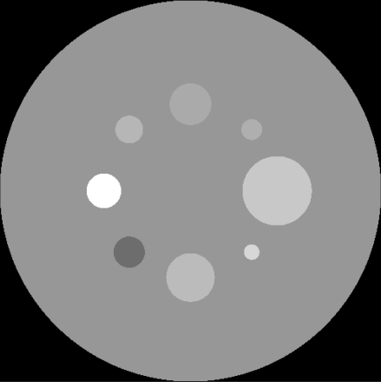
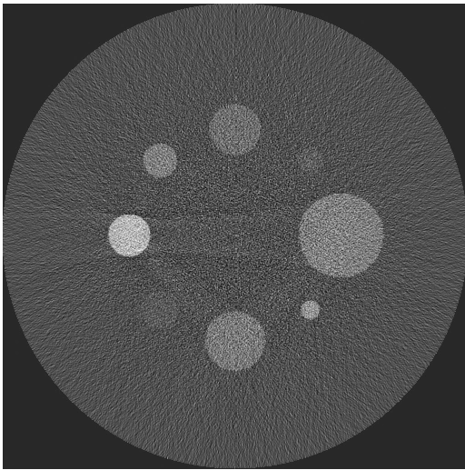
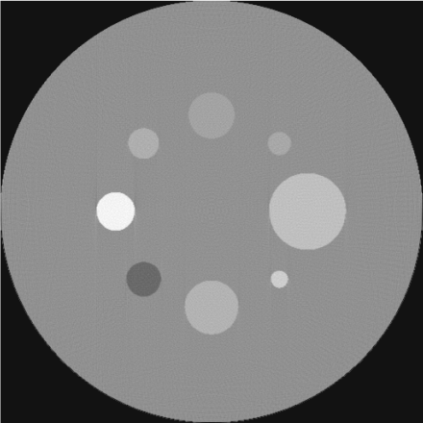
Projection Decomposition
PE
Compton
Truth
Recon

Slide 10
Dual-energy Neural Network
I₁
I₂
Radial Basis Function (RBF) neural network
I₁ and I₂ are measured intensities of dual-energy data. Monochromatic projection =
The neural network is trained for projection decomposition from dual-energy data

Slide 11
Radial Basis Function (RBF) method
PE
Compton
Truth
Recon

Slide 12
Outline
Introduction
Dual-energy Data Decomposition
Monochromatic Imaging
Discussions

Slide 13
X-ray CT Physical Model
Model Mismatch!

Slide 14
Physical Model
Based on the integral mean value formula, there is a energy for any x-ray path such that the measured intensity can be exactly formulated as a line integral:
Energy relies on the x-ray path and materials.
The polychromatic x-ray spectrum is the reason for beam-hardening in conventional CT images

Slide 15
Physical Model
For an attenuation image at a specific energy level the line integral is accurate:
The purpose is to compensate for inconsistent energy levels to match the ideal model through a function :

Slide 16
Learning from Sinogram Data
The map can be established to describe the relationship between ideal data and CT images using deep learning techniques:
The trained neural network will produce accurate data to overcome the beam-hardening problem and even facilitate monochromatic CT imaging.

Slide 17
Deep Learning
Input data X= (x₁, x₂,…,x_{m})
x₁
x₂
x₃
x_{m}
is grayscale image pixel values associated with an x-ray beam, and
P is a corresponding monochromatic projective value

Slide 18
Network training
Neural network was designed to have four layers, one input layer, two hidden layers, and one output layer
Activation function is rectified Linear Unit (ReLU)
Training procedure was run in the TensorFlow framework
Training is based on numerical simulation to generate monochromatic projection
We just got real data with multiple energy in processing

Slide 19
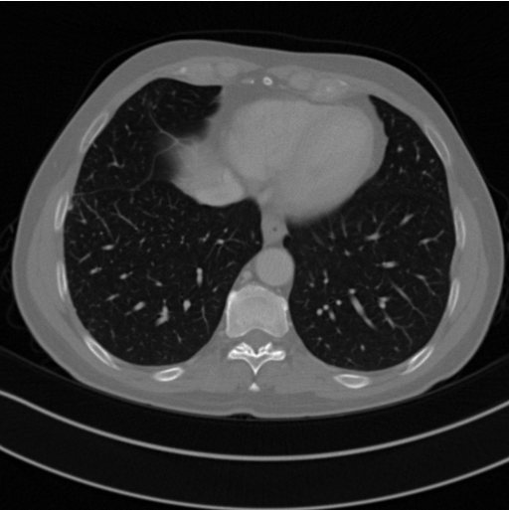
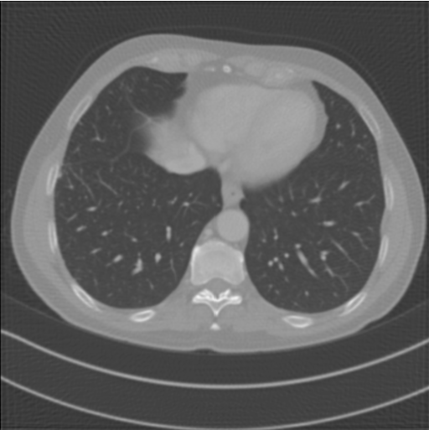
Numerical Simulation
(a)
(b)
Monochromatic reconstruction. (a) The ground truth, (b) the reconstructed image via deep learning.

Slide 20
Outline
Introduction
Dual-energy Data Decomposition
Monochromatic Imaging
Discussions

Slide 21
Discussions
Realistic simulation with visible human datasets and others of similar nature
Work in progress, processing more real datasets for the neural network training
Deeper & more advanced neural network structures

Slide 22
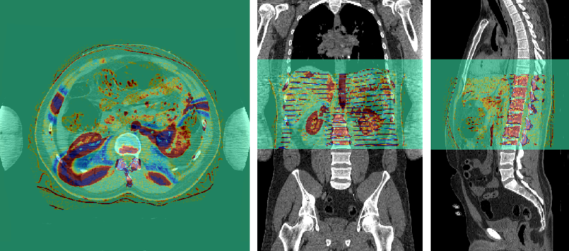
Colorized Visible Human
Based on dual-energy CT scans, we can generate real monochromatic training datasets for deep reconstruction (work in progress, in collaboration with professors with BIT, China)

Slide 23
Thanks！

