Slide 1
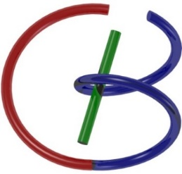
CT Metal Artifact Reduction
via Image-Domain Learning
Lars Gjesteby, Hongming Shan, Qingsong Yang, Ge Wang
Biomedical Imaging Center, CBIS/BME/SoE
Rensselaer Polytechnic Institute
November 19, 2017

Slide 2
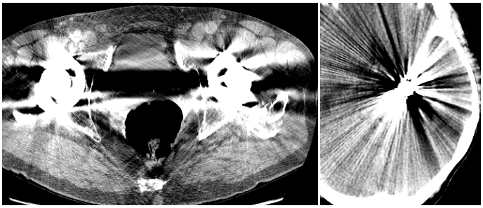
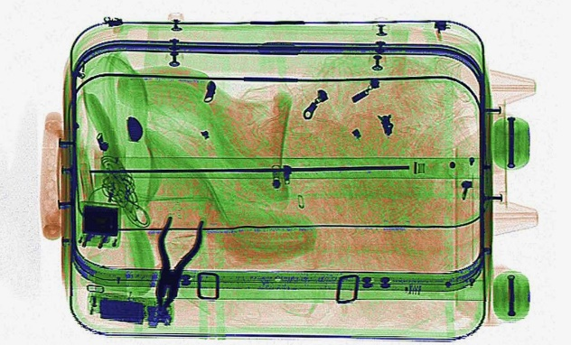
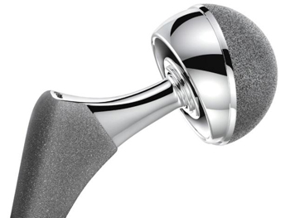
Metal Artifacts
Metallic/dense objects cause severe metal artifacts
Existing metal artifact reduction (MAR) algorithms are imperfect
Relevant to medical imaging and airport scans of luggage
Smart techniques (machine learning/deep learning/CNN/ etc.) can improve MAR

Slide 3
Metal Artifact Reduction
Metal objects corrupt CT images
Beam-hardening, scatter, noise
Projection completion¹⁻³
Iterative reconstruction⁴
Image-based post-processing⁵
NMAR [3]
Image quality remains insufficient (RT planning⁶)
1. W. Kalender et al., Radiology, 164(2), 1987.
2. M. Bal and L. Spies, Medical Physics, 33(8), 2006.
3. E. Meyer et al., Medical Physics, 37(10), 2010 (Referred to as NMAR)
4. J. Stayman et al., IEEE Trans. Med. Imag., 31(10), 2012.
5. O. Watzke et al., European Radiology, 14(5), 2004.
6. C. Reft, et al., Medical Physics 30(6), 2003.
7. L. Gjesteby et al., IEEE Access, 4, 2016 (Literature review)

Slide 4
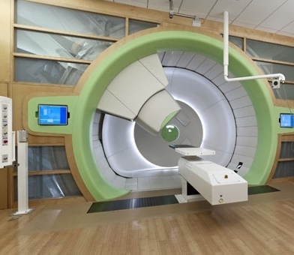
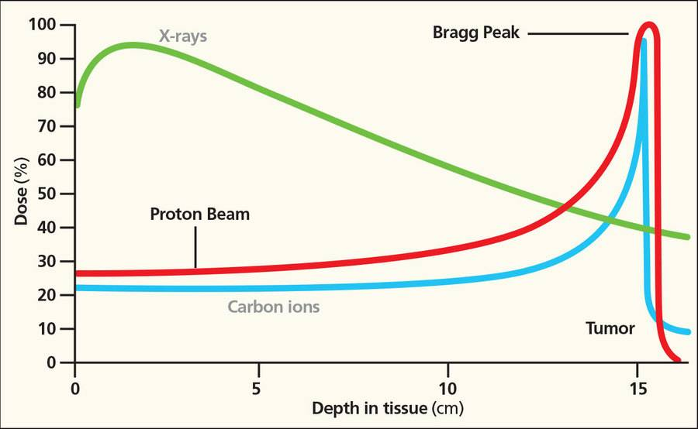
Proton Therapy
Energy lost by charged particles is inversely proportional to the square of their velocity
Precise localization of tumor is essential to ensure successful treatment

Slide 5
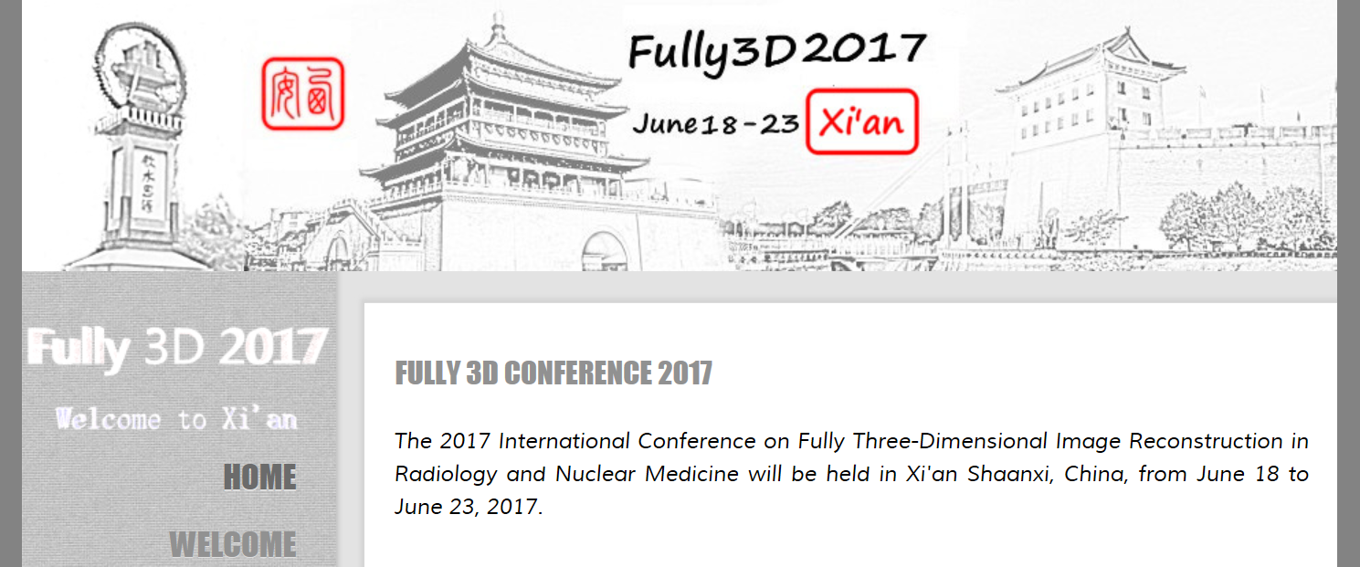
Data
Domain
Image
Domain

Slide 6
Superiority Principle of Deep Learning
Train a convolutional neural network (CNN) on various types of artifacts
Take advantage of initial correction by proven MAR algorithms (NMAR)
Do no worse than the state-of-the-art
More inputs, better quality (conclusions from Prof. Yu’s group)
CNN
More artifact reduction;
Better image quality
State-of-the-art MAR results

Slide 7
Data Generation
Voxelized phantoms from the Visible Human Project: pelvis and spine regions
Industrial-grade CT simulator (CatSim, GE Global Research Center)
Fan-beam geometry
120 kVp, 300 mA, 720 views
Metal-free (ground truth)
Titanium-added
NMAR algorithm applied
60 image slices, 512x512
100k 48x48 patches for training; 15k for testing/validation

Slide 8
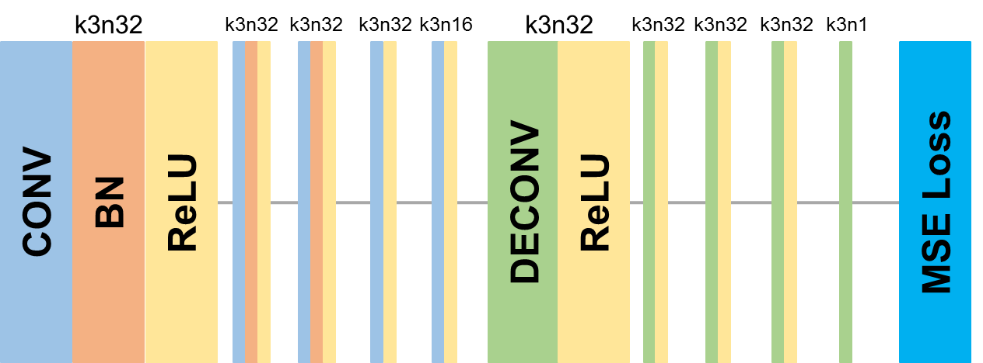
Learning in the Image Domain
Input image: Already with correction from NMAR algorithm
Output image: Further MAR through CNN
CNN: Five convolution and five deconvolution layers
Supervised learning: Ground truth from simulation and/or experiments
…
…
3x3 kernel size
Number of filters denoted by n
Batch normalization (BN) in the first three layers
ReLU for activation

Slide 9
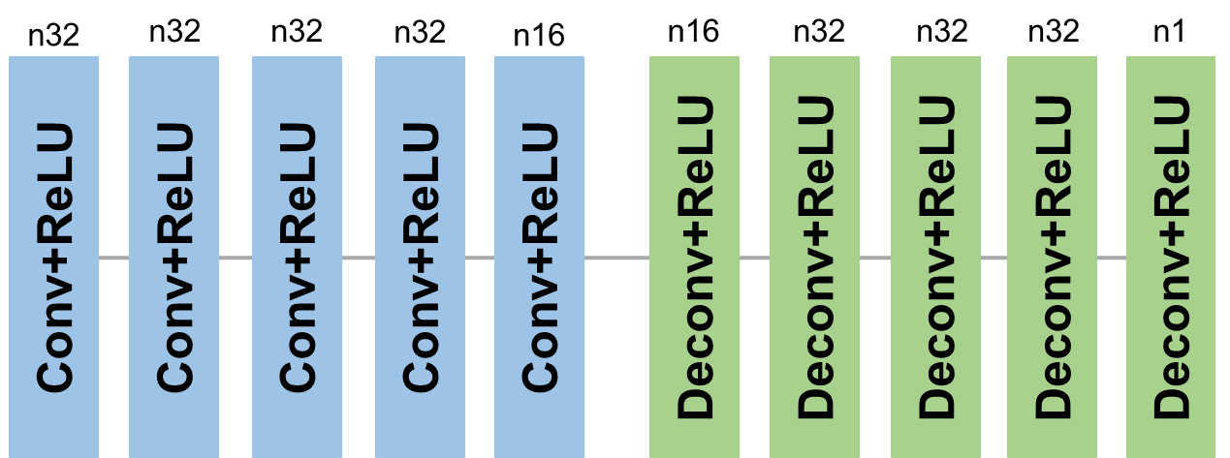
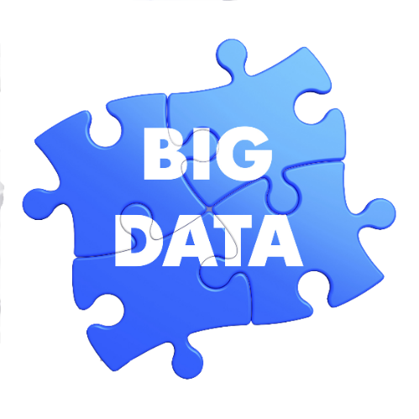
CNN with WGAN
Truth Image
VGG Network
Truth Feature
Tuning
Perceptual Loss
CNN Generator
Output Feature
Generated Output Image
Loss
TensorFlow
Hyperparameters:
Learning rate: $\frac{{10}^{−3}}{\sqrt{Epoch}}$
Batch size: 128
# of epochs: 40
Discriminator
Adversarial Loss
Truth Image
Tuning

Slide 10
Experiments
CNN-MSE
MSE loss function
CNN-WGAN-VGG
VGG perceptual loss in the WGAN framework
CPCA-WGAN-VGG
VGG perceptual loss in the WGAN framework with a modified generator (contracting path convolutional autoencoder)

Slide 11
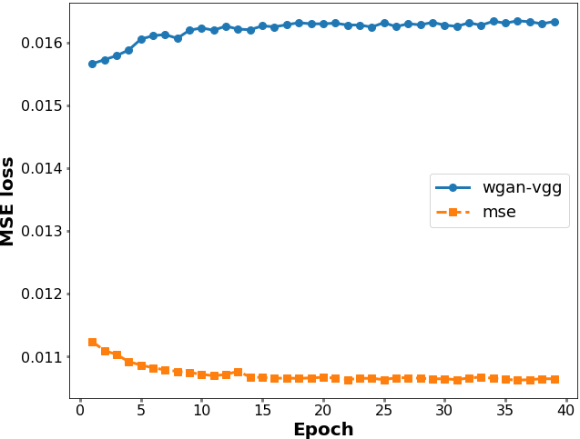
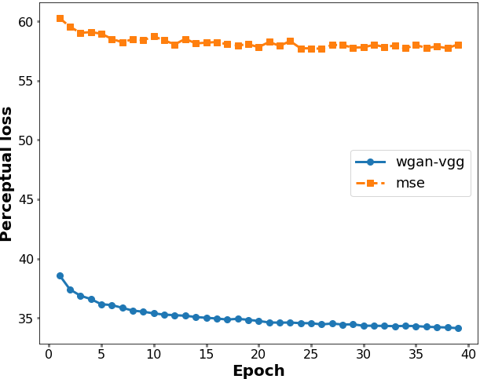
Testing Loss Curves

Slide 12
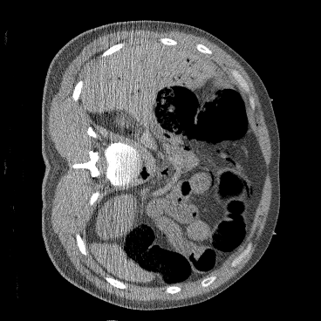
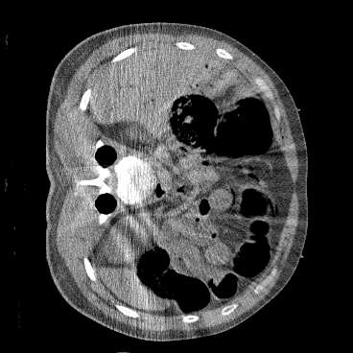
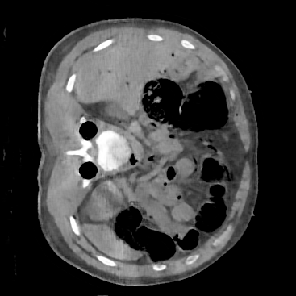
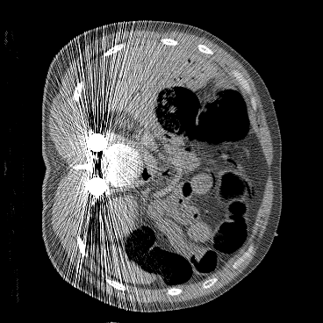
Spinal Fixation Rods
Metal-free Truth
NMAR
CNN-MSE
MSE: 0.0903
SSIM: 0.3590
PSNR: 10.4454
MSE: 0.0065
SSIM: 0.7600
PSNR: 21.8702
Uncorrected
CPCA-WGAN-VGG
CNN-WGAN-VGG
MSE: 0.0092
SSIM: 0.7228
PSNR: 20.3856
MSE: 0.0104
SSIM: 0.7085
PSNR: 19.8411

Slide 13
Enlarged ROIs
Metal-free Truth
NMAR
CNN-MSE
Uncorrected
CPCA-WGAN-VGG
CNN-WGAN-VGG

Slide 14
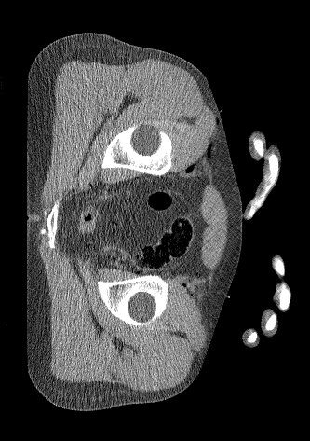
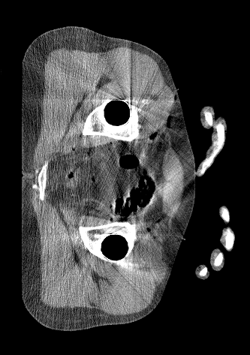
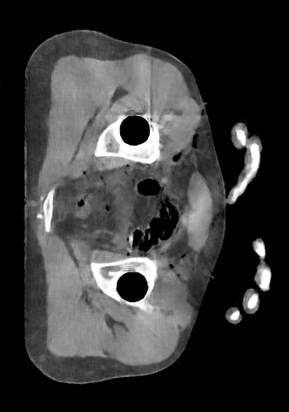
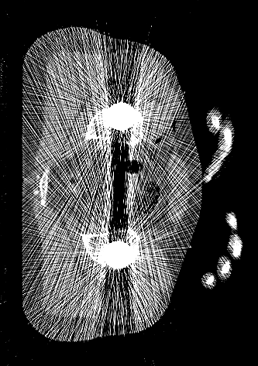
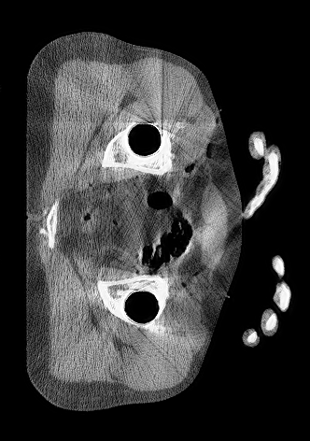
Hip Prostheses
Metal-free Truth
NMAR
CNN-MSE
MSE: 0.1156
SSIM: 0.3431
PSNR: 9.3687
MSE: 0.0109
SSIM: 0.6783
PSNR: 19.6452
Uncorrected
CPCA-WGAN-VGG
CNN-WGAN-VGG
MSE: 0.0149
SSIM: 0.6371
PSNR: 18.2712
MSE: 0.0147
SSIM: 0.6357
PSNR: 18.3168

Slide 15
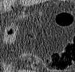
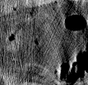
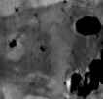
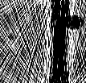
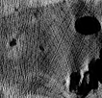
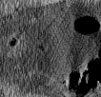
Enlarged ROIs
Metal-free Truth
NMAR
CNN-MSE
Uncorrected
CPCA-WGAN-VGG
CNN-WGAN-VGG

Slide 16
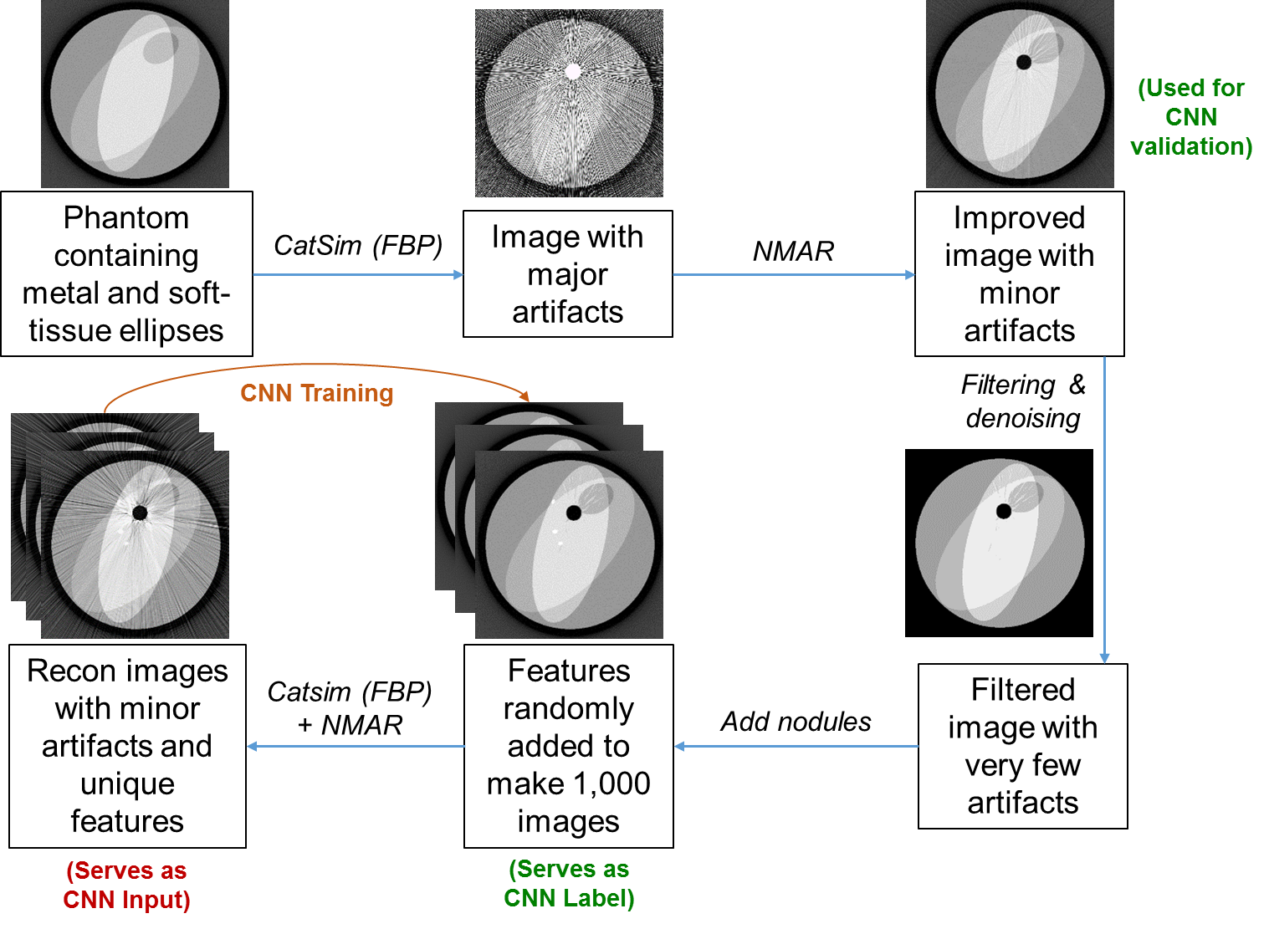
MAR-CNN Training with Pseudo Truth

Slide 17
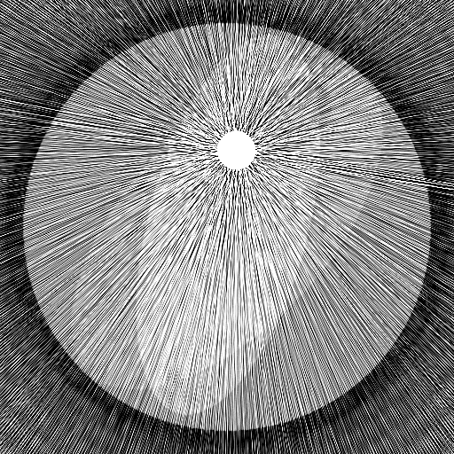
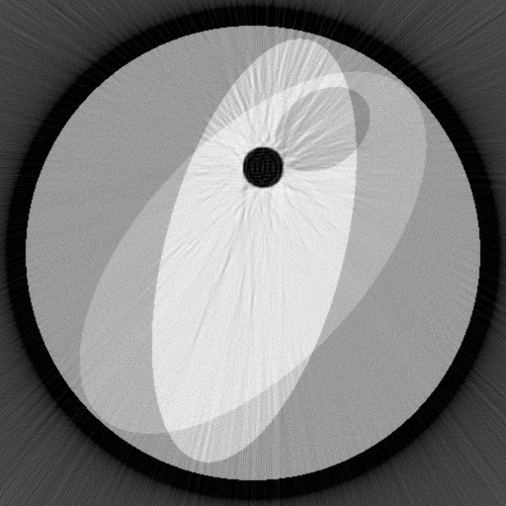
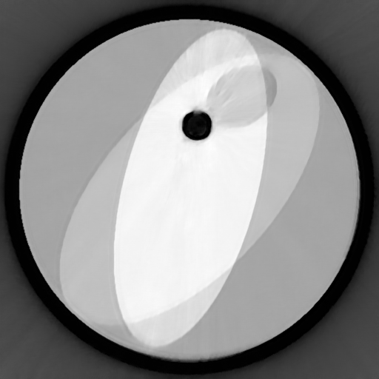
Pilot Results (IP Pending at RPI)
Metal-free Truth
Uncorrected
NMAR (CNN Input)
CNN-MSE
CNN-WGAN-VGG

Slide 18
Discussions & Conclusion
Deep learning helps recover anatomical structures and tissue types when existing MAR algorithms are insufficient
Image domain methods have merits
Pseudo-truth could be powerful
Data and image domains will be combined in the future

Slide 19
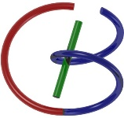
Thank You!
Biomedical Imaging Center
Principal Investigator: Ge Wang
Wenxiang Cong
Guang Li
Hongming Shan
Ruibin Feng
Tao Xu
Qingsong Yang
Matthew Getzin
Lars Gjesteby
Fenglei Fan
Qing Lyu

