Slide 1

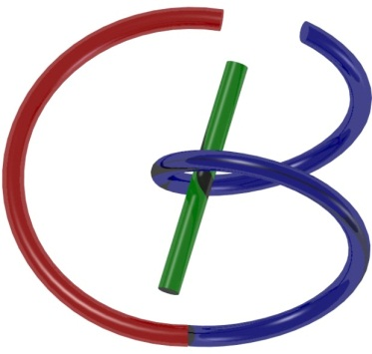

New Type of Neurons for
Machine Learning
Fenglei Fan, Wenxiang Cong, and Ge Wang
Biomedical Imaging Center, CBIS/BME, RPI
November 19, 2017

Slide 2
Biological & Artificial Neurons
Branches (Dendrite)
Body (Soma)
Interface (Synapsis)
Fiber (Axon)
Input
Output
Biological Neuron
Summation (Linear)
Weight
Transformation (Nonlinear)
Input
Output
Artificial Neuron

Slide 3
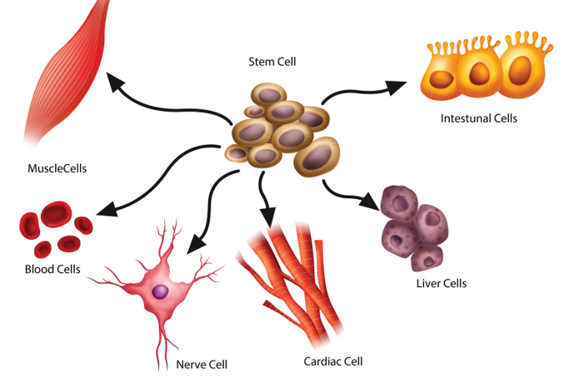
Basic Types of Cells

Slide 4
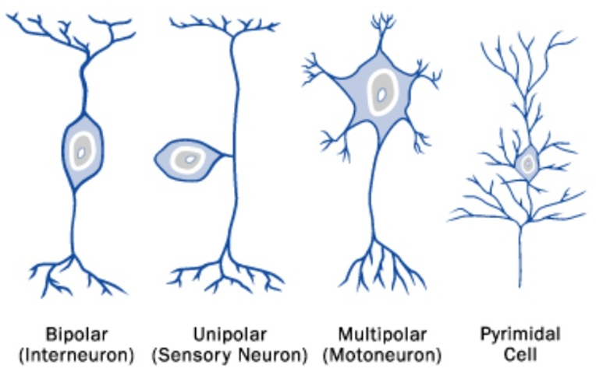
Basic Types of Neurons

Slide 5
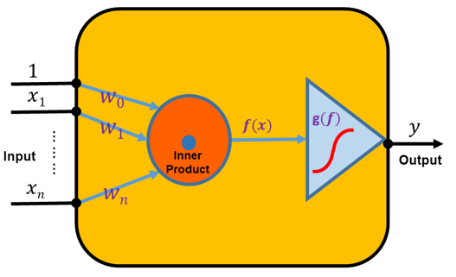
Artificial Neuron

Slide 6
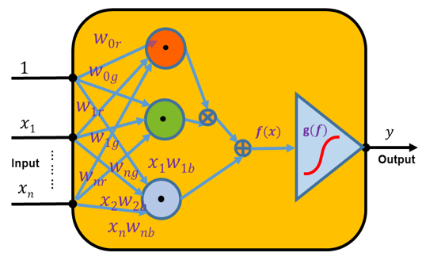
New Type of Neurons

Slide 7
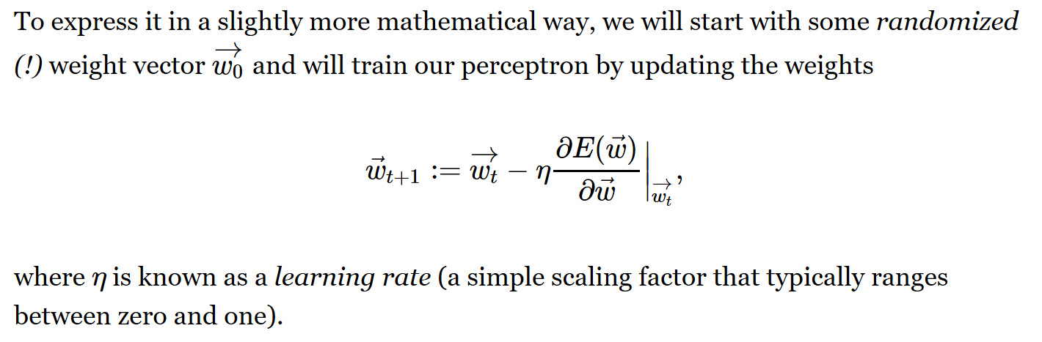
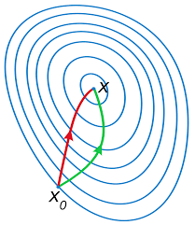
Gradient Descent Search

Slide 8
Back Propagation
Training Set
Test Set

Slide 9
Telling-Two-Spirals-Apart
Lang and Witbrock reported that the standard backpropagation feedforward network cannot classify such spirals without shortcuts
KJ Lang, MJ Witbrock: Learning to Tell Two Spirals Spart. In Proceedings of the 1988 Connectionist Models Summer School. Morgan Kaufmann, San Mateo, CA, 52-59, 1989

Slide 10
Current Network Proposed Network
2-5-8-1 2-3-2-1

Slide 11
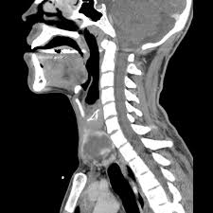
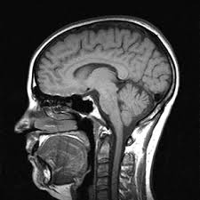
CT & MRI Images

Slide 12
Sorting CT & MRI Images

Slide 13
Future Work
LeNet
ShuffleNet
ResNet
MNIST
ImageNet
CIFAR
COCO
DenseNet
GeNet?

