Slide 2
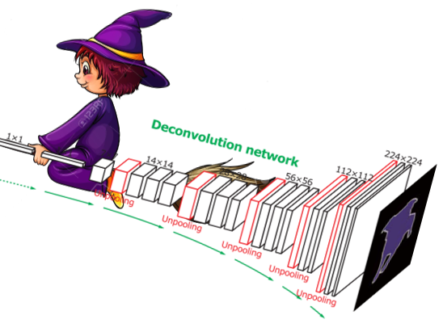
Magic Power, Limited by Sky
October 31, 2017

Slide 4
NIH

Slide 5
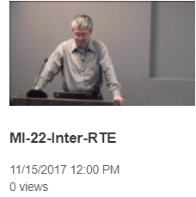
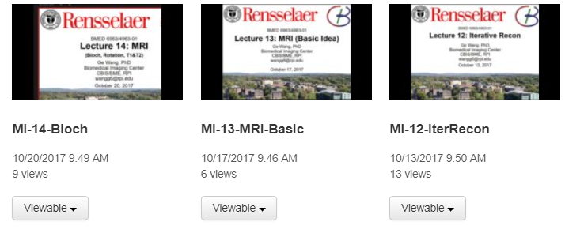
Thanks for Teaching RPI Students

Slide 6
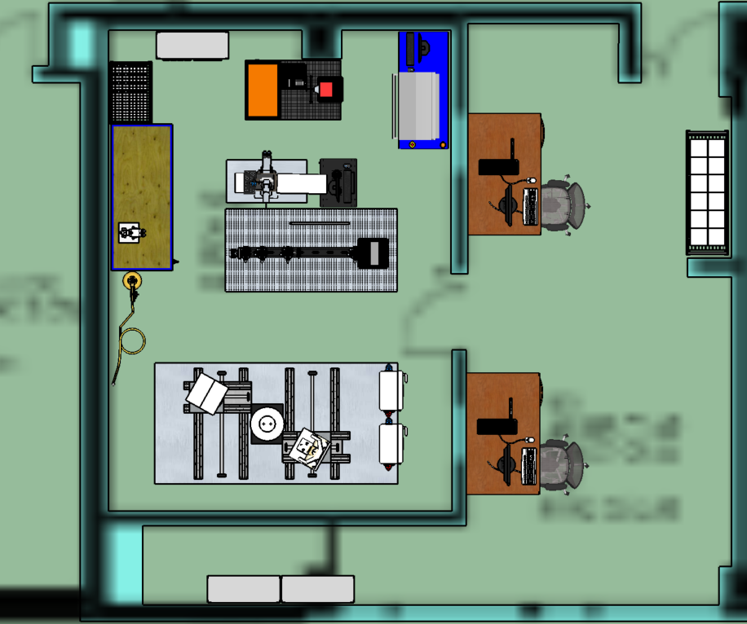
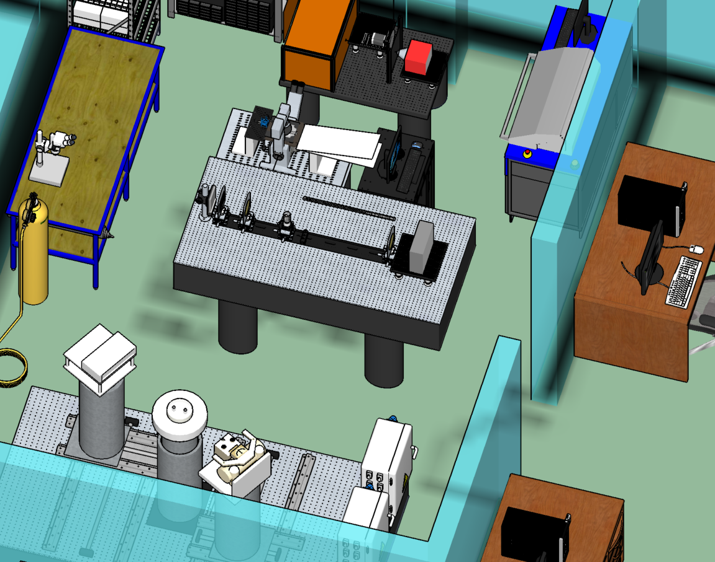
Welcome to Our Lab
Photon-counting Micro-CT
X-ray Electrophysiology Platform
X-ray Electrophysiology Platform
Photon-counting Micro-CT
X-ray Talbot-Lau Interferometer
X-ray Talbot-Lau Interferometer
CT Benchtop
CT Benchtop
~100m Away in the Building
Ask Any Lab Member for a Tour

