Slide 1
Machine Learning / Deep Learning
Deep Recon
Data / Features to Images
Image Analysis
Images to Images / Features
Radiomics
Images to Signature / Diagnosis
Deep Imaging
Whole Workflow

Slide 2
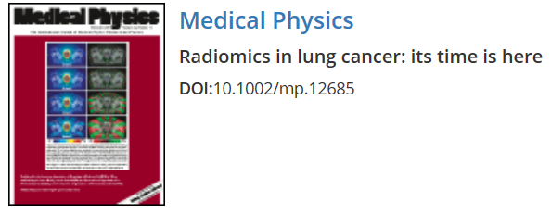
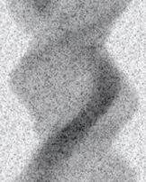
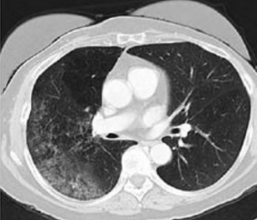
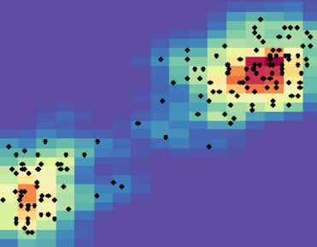
Rawdiomics
Past
Normal Dataset
Analytic Recon
Crafted Features
Statistical Model
Present
Low-dose Dataset
Iterative Recon
CNN-based Features
Trained Network
Future
Low-dose Dataset
FBP Network
Improvement Network
Recon Image
ROI Segmentation
Deep Features
Final Diagnosis
Deep Recon
Rawdiomics
Deep Radiomics

Slide 3
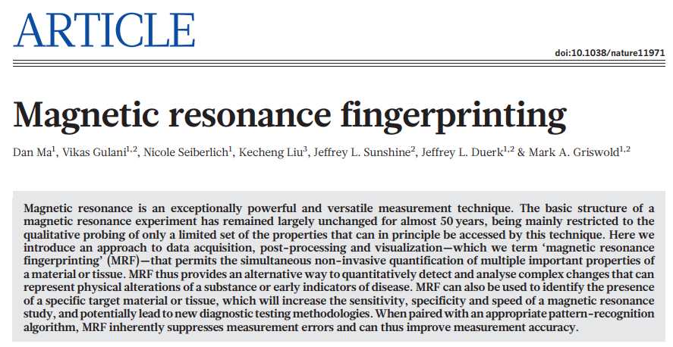
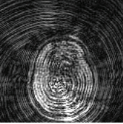
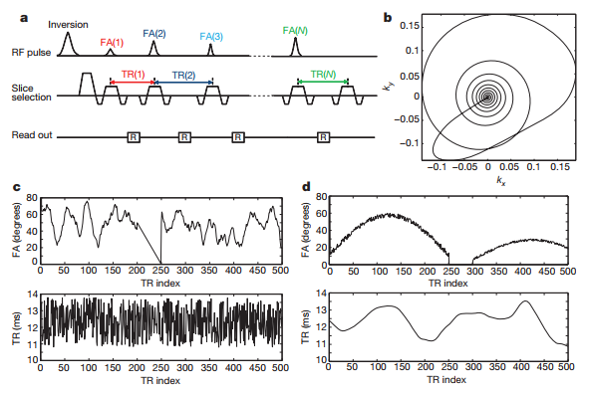
Rediomics

Slide 4
= Reading &
Diagnosis

Slide 5
Qualtrics
Please email us if you have any questions that you want to survey within a week!

